Slide 1


Stability Analysis of Delayed Feedback in Mobile Robot Trajectories Using DDE23 Integration
Presented by:
Neriya Hadad
Liel Tsemah
Ariel Cohen
Advisor:
Dr Oleg Kupervasser

Slide 2
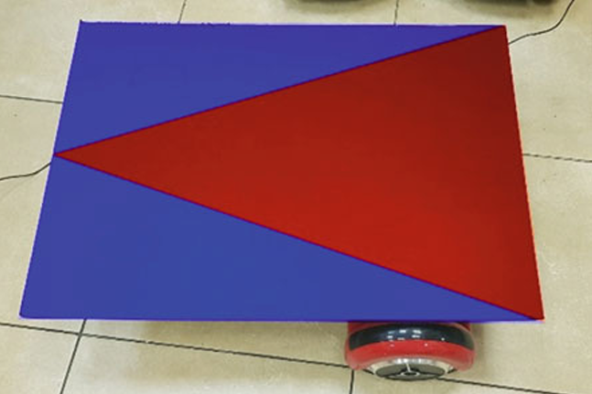
Based on the article “A Method for Stabilization of Ground Robot Path Controlled by Airborne Autopilot with Time Delay”
simulation using MATLAB for the motion of the ground robot based on solving differential equations with delay
Stability analysis of the system under different control parameters, and comparison of the simulation results to the data in the article

Slide 3

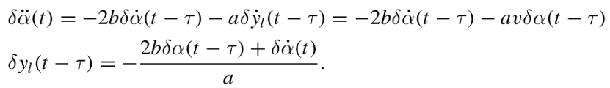
This project aims to:
Numerically solve delay differential equations using MATLAB’s dde23.
Validate the theoretical findings of the article through practical simulation.
Determine the boundary of practical stability under time-delay conditions.
The differential equations addressed in this work are:

Slide 4
Novelty & Contributions
Practical implementation of the theoretical model using MATLAB’s dde23 solver, making the abstract equations executable and testable.
Mapped the stability transition with high resolution by gradually varying the delay parameter (Ʈ), pinpointing the practical critical value.
Bridged the gap between theory and simulation by validating the model under realistic conditions (e.g., noise-free, continuous delay).
Provided a visual and analytical interpretation of system behavior across stable, marginal, and unstable regimes.

Slide 5
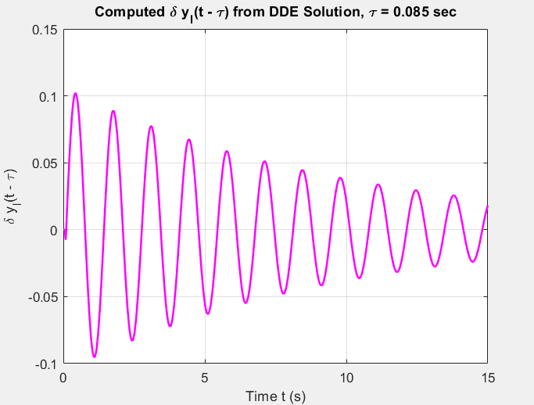
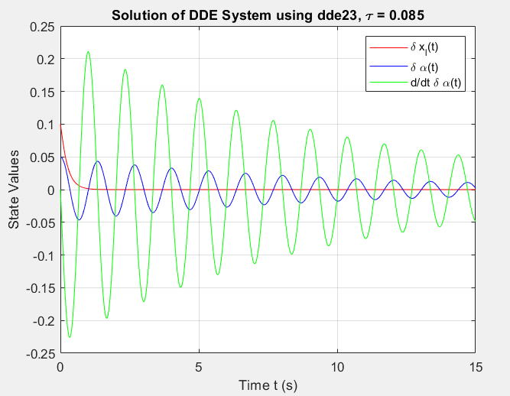
Stable systems that comply with the article's boundaries

Slide 6
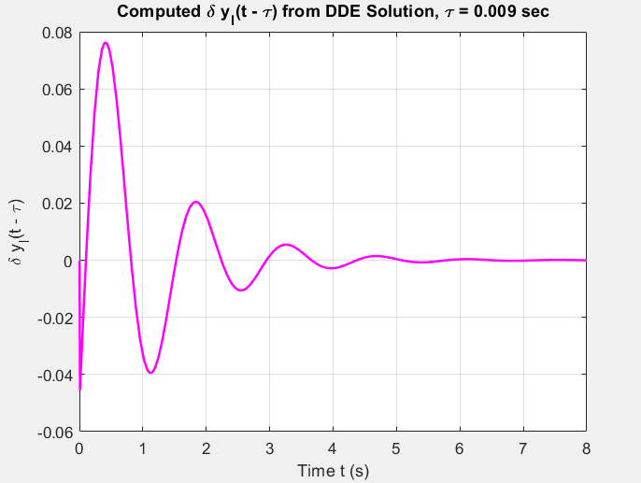
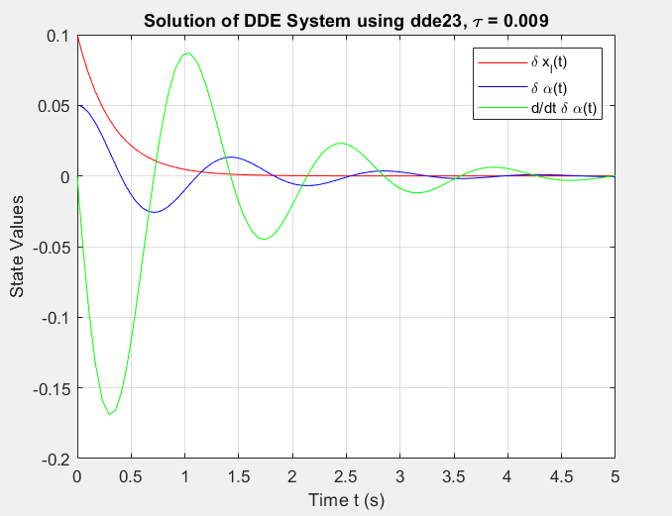
Stable systems that comply with the article's boundaries

Slide 7
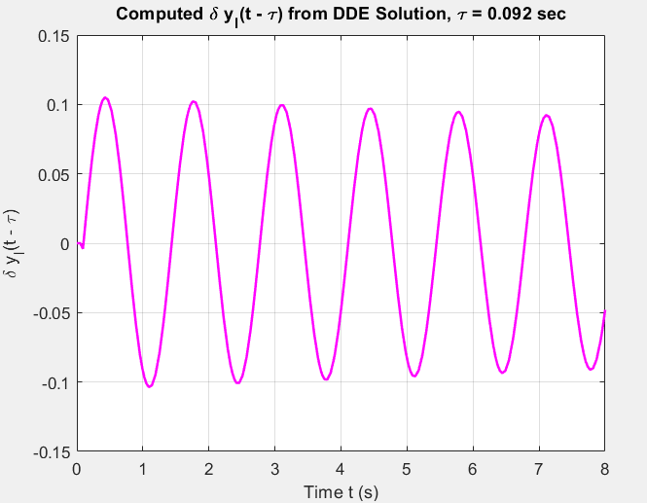
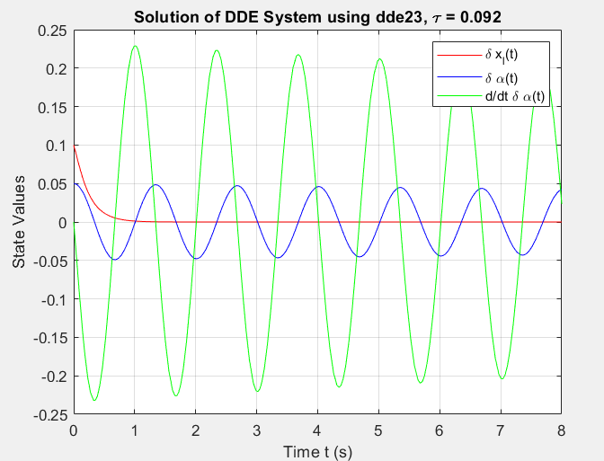
Systems on the verge of instability at the boundary defined by the article

Slide 8
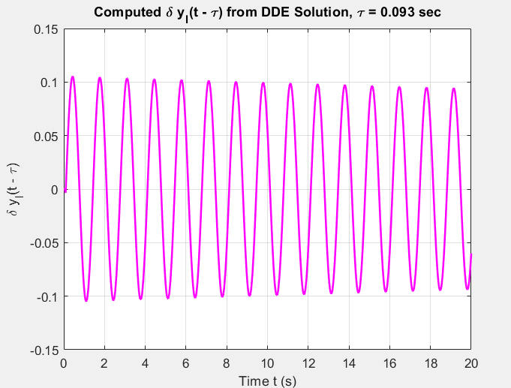
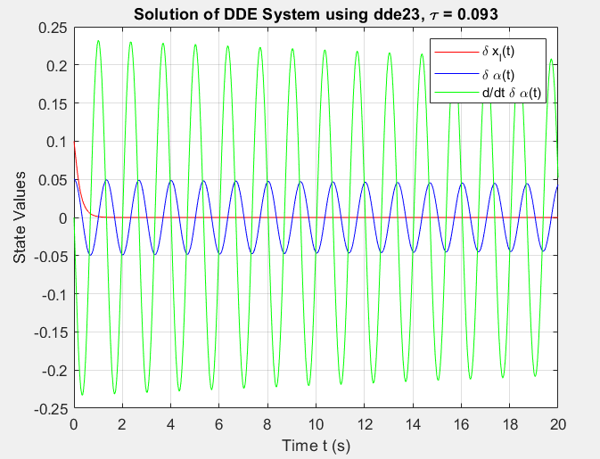
Systems on the Verge of Practical Instability

Slide 9
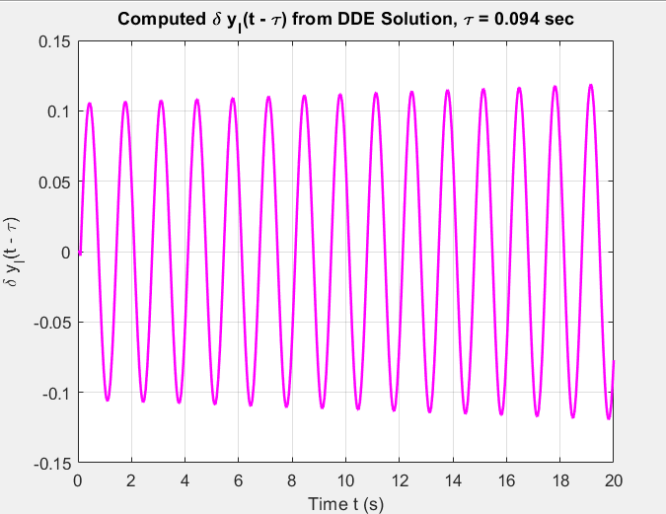
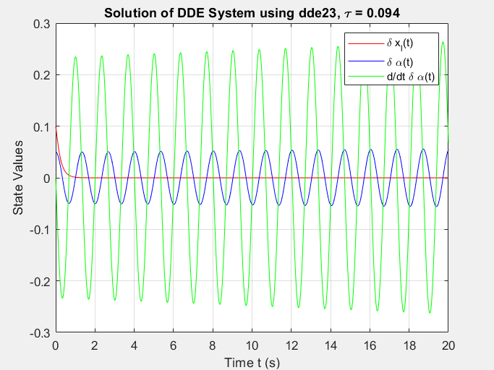
Unstable Systems

Slide 10
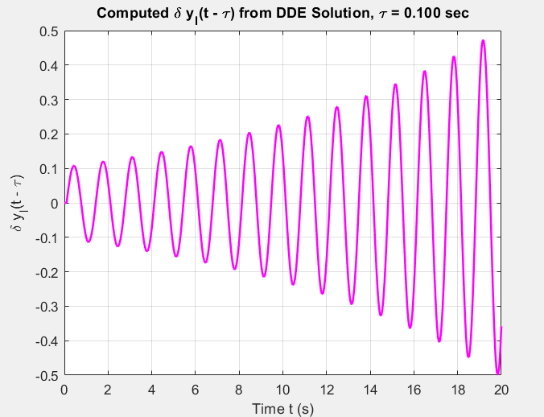
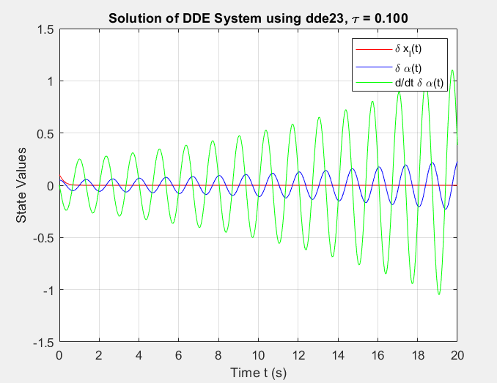
Unstable Systems

Slide 11
Practical Applications
Autonomous ground robots: Ensuring stable path-following even with delayed sensor feedback or remote instructions.
Drone-to-ground coordination: Designing controllers for mobile robots receiving navigation data from UAVs over wireless links with latency.
Industrial automation: Systems with PLCs or remote feedback can benefit from similar delay-aware modeling to avoid oscillations or instability.
Teleoperated vehicles (e.g., bomb squad, search-and-rescue robots): Systems with operator-to-robot latency can use such models for controller tuning.

Slide 12
Summary & Conclusions
The time delay parameter (Ʈ) has a significant impact on the stability of the robot's trajectory
A range of stable parameters was identified, with a critical delay threshold at Ʈ=0.093, beyond which the system becomes unstable
The use of MATLAB’s dde23 solver enabled precise simulation of delayed feedback systems and allowed us to evaluate system behavior under varying delay values
The simulation results were highly consistent with the findings of the referenced article, including the identification of a transition point into instability.
This project demonstrates how theoretical models of delayed systems can be validated in practice through numerical simulation
The validated model provides a practical tool for designing control systems that involve communication or actuation delays

Slide 13
Based on the Following Research Article
Title: A Method for Stabilization of Ground Robot Path Controlled by Airborne Autopilot with Time Delay
Authors: Alexander Domoshnitsky, Oleg Kupervasser, Hennadii Kutomanov, Roman Yavich
Published in: Springer Proceedings in Mathematics & Statistics, Volume 379
Conference: FDEA 2019 – Functional Differential Equations and Applications Ariel University, Israel | September 22–27, 2019

